Slide 1
Acta E Articles: Frequently Encountered Problems and Hints for Evaluating Structures of Inorganic and Metal-Organic Compounds
Matthias Weil
mweil@mail.zserv.tuwien.ac.at

Slide 2
Category
Although the wrong category is a minor problem (without
consequences; the wrong category is usually corrected at the proof
stage by technical editors or section editors), co-editors are
encouraged to check the correct category:
_publ_requested_category
EI for inorganics
(no C─C and/or C─H bonds)
EM for metal organics
(at least one metal and C─C and/or C─H bonds must be present)
EO for organics
(no metals, but semi-metals like Se, Te can be present)

Slide 3

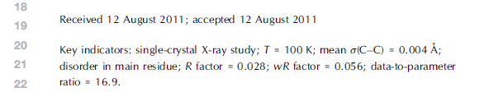
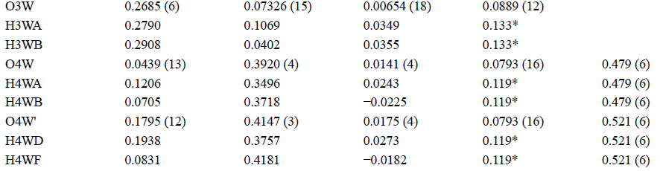
Disorder
Key indicators in the published paper
Treatment of disorder should be reported in the Abstract with
numerical values for the occupancies (including s.u.) and in more
detail in _publ_section_exptl_refinement
An easy way to check disorder: Just look into the review *.pdf

Slide 4
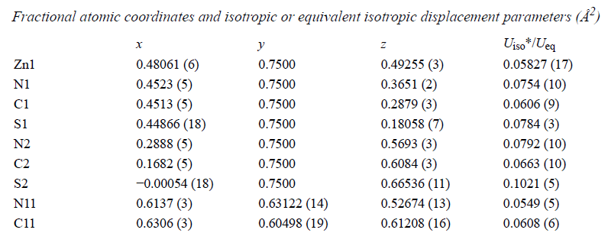

Special positions
Special positions or symmetry should be reported in the Abstract!
E.g. : … the Fe(II) atom is located on an inversion centre …;
… the MgO₆ octahedron has .m. symmetry …
But not: The asymmetric unit contains one ligand molecule and
half of a metal atom (there are no half-/quater/- etc. atoms!)
How to spot special positions in an easy way?
Check coordinates in the review *.pdf → Wyckoff positions in IT A
Or check the structure visually with PLATON
or the freely downloadable Mercury

Slide 5
http://www.ccdc.cam.ac.uk/products/mercury/
Load CIF
Display
Symmetry Elements

Slide 6
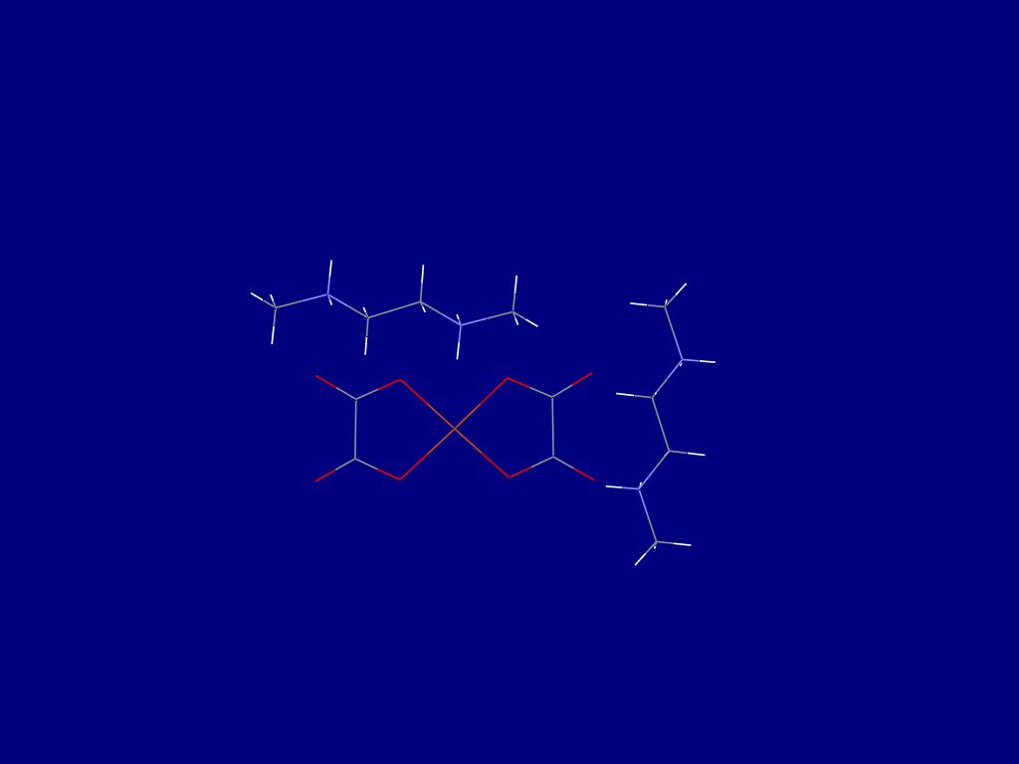
http://www.ccdc.cam.ac.uk/products/mercury/
Load CIF
Display
Symmetry Elements
N,N'-Dimethylethylenediammonium dioxalatocuprate(II)

Slide 7
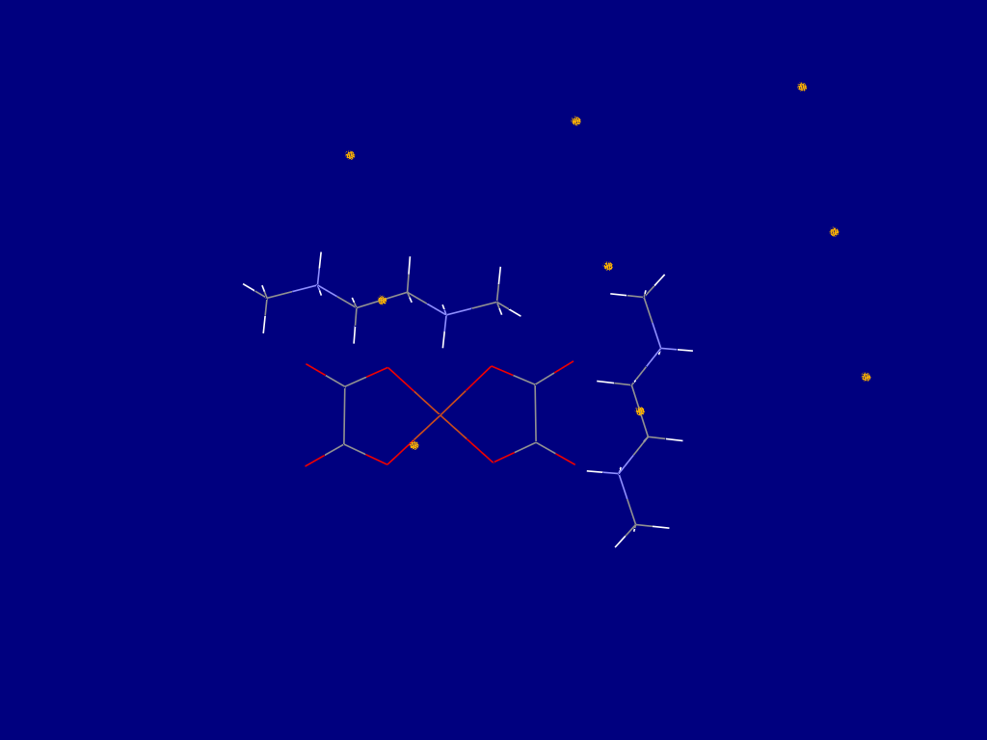
N,N'-Dimethylethylenediammonium dioxalatocuprate(II)
http://www.ccdc.cam.ac.uk/products/mercury/
Load CIF
Display
Symmetry Elements
N,N'-Dimethylethylenediammonium dioxalatocuprate(II)
Inversion symmetry cation

Slide 8
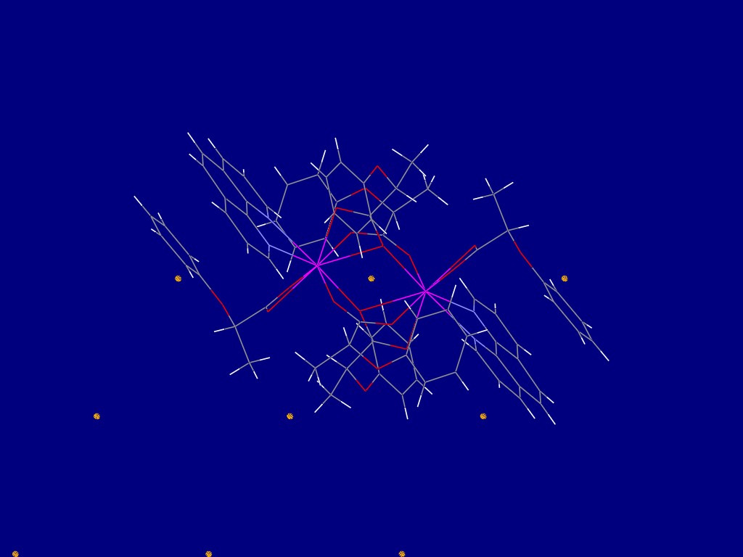
Tetrakis(μ₂-2-phenoxypropionato-κ³-O,O‚O‘‚-κ³O,O,O,-κ⁴O,O‚)-bis[(2-phenoxypropionato-κ²-O,O')(1,10-phenanthroline-κ²⁻N,N‘) gadolinium(III)]
N,N'-Dimethylethylenediammonium dioxalatocuprate(II)
http://www.ccdc.cam.ac.uk/products/mercury/
Load CIF
Display
Symmetry Elements
N,N'-Dimethylethylenediammonium dioxalatocuprate(II)
Inversion symmetry cation
Inversion symmetry
dimeric complex

Slide 9
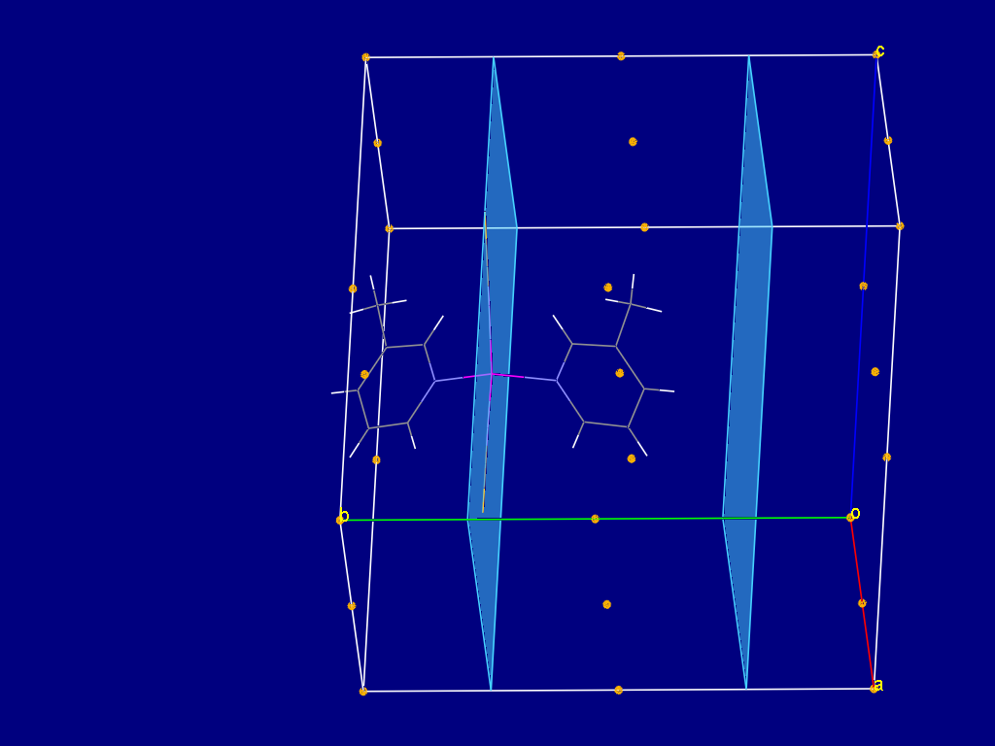
Bis(3-methylpyridine- κN)bis(thiocyanato- κN)zinc
Tetrakis(μ₂-2-phenoxypropionato-κ³-O,O‚O‘‚-κ³O,O,O,-κ⁴O,O‚)-bis[(2-phenoxypropionato-κ²-O,O')(1,10-phenanthroline-κ²⁻N,N‘) gadolinium(III)]
N,N'-Dimethylethylenediammonium dioxalatocuprate(II)
http://www.ccdc.cam.ac.uk/products/mercury/
Load CIF
Display
Symmetry Elements
N,N'-Dimethylethylenediammonium dioxalatocuprate(II)
Inversion symmetry cation
Mirror symmetry
for the entire complex
Inversion symmetry
dimeric complex

Slide 10
Coordination numbers and polyhedra
Report coordination number(s) and/or corresponding polyhedra for
metal atoms in the Abstract. This can be supplemented by flagged
metal—ligand atom distances to be published in Table 1
Mn OH3 1.9149(11) 3_665 y
Mn OH3 1.9149(11) 8_455 ?
Mn OH3 1.9149(11) 1_455 ?
Mn OH3 1.9149(11) 2_545 ?
Mn OH3 1.9149(11) 7_545 ?
Mn OH3 1.9149(11) 9_665 ?
Ca O2 2.3465(11) 4 y
Ca O2 2.3465(11) . ?
Ca OH3 2.456(5) 3_665 y
Ca OH3 2.456(5) 6_665 ?
Ca OH3 2.518(5) 1_455 ?
Ca OH3 2.518(5) 4_455 y
Ca OW4 2.578(9) . y
Ca OW4 2.690(9) 3_565 y
Symmetry-related distances should not be flagged since point group
symmetries of the polyhedra should be indicated in the Abstract in any
event. Angles around metal atoms are usually of no great insight.

Slide 11
Coordination numbers and polyhedra
Coordination polyhedra (coordination numbers) are very good
measures for the correctness of a metal! Some metal ions are known
to have peculiar coordination polyhedra (and vice versa):
CN = 2
Linear coordination for ions like Ag(I), Hg(II), Au(I) …
CN = 3
Trigonal-planar (T-shaped) coordination for ions like Ag(I), Cu(I), …
CN = 4
• Tetrahedral coordination for ions like Li(I), Co(II), Al(III), Sn(IV), …
• Square-planar coordination frequent for d⁸ ions (Ni(II), Pt(II), Pd(II));
sometimes for Cu(II) apparent from the *.lst file when long distances
are not recognized (‚low‘ CONN instruction in SHELXL); extremely
unusual (if existing at all) for ions like Fe(II/III), Co(II/III), Zn(II), …

Slide 12
Coordination numbers and polyhedra
CN = 5
• Trigonal-bipyramidal coordination for ions like Al(III), Sn(IV), Zn(II), …
• Square-pyramidal coordination for ions like Cu(II), Ni(II), V(V), …
CN = 6
• Octahedral coordination for ions like Mg(II), Al(III), Mn(II), Cr(III), …
Jahn-Teller effect results in a considerably tetragonally distorted
octahedron ([4+2] coordination with two long metal-ligand distances)
and is pronounced for ions Mn(III), Cr(II), Cu(II)
• Trigonal-prismatic coordination for ions like Mo(VI), Zr(IV), …
CN ≥ 7
Frequently very distorted polyhedra for ions with larger ionic radius
like Na(I), Ca(II), RE(III), …

Slide 13
Other very useful criteria to check the correctness of a metal:
Bond lengths!
Inorganics: Bergerhoff & Brandenburg, Int. Tables C, p 771-780.
Metal-organics: Orpen et al., Int. Tables C, p 804-888.
Bond valence sums (BVS)!
N.E. Brese & M. O'Keeffe (1991). Acta Cryst. B47, 192-197.
I.D. Brown (2002). The chemical bond in inorganic chemistry :
the bond valence model. IUCr Monographs in Crystallography 12
Software available for calculation of BVS:
http://www.ccp14.ac.uk/solution/bond_valence/index.html
PLATON also allows to calculate BVS

Slide 14
Crystallographic directions
In the Abstract, crystal packing features in terms of chain or layer
formation are discussed, e.g.
– „ …and the metal atoms are bridged by the oxalate ligands,
resulting in the formation of a helical chain.“
- „Intermolecular O –H…O hydrogen bonding interactions lead to a
two-dimensional set up.“
Such features should always be completed by indicating the
crystallographic directions:
„… of a helical chain extending parallel to [100] (to the a axis)“
[brackets denote a direction vector]
„ …to a two-dimensional set up parallel to (100) (to the bc plane)“
(parentheses denote planes)

Slide 15


Order of atoms
In the CIF the order
N1 Pd 2.072(9) . ?
N1 H1 0.85(2) . ?
N2 Pd 2.005(11) . ?
N2 H10 0.85(2) . ?
O1 Pd 1.976(8) . ?
O3 H8 0.86(2) . ?
O5 Pd 2.024(7) . ?
...
is often confusing
whereas the order
Pd O1 1.976(8) . ?
Pd N2 2.005(11) . ?
Pd O5 2.024(7) . ?
Pd N1 2.0724(9) . ?
O1 C1 1.307(14) . ?
O2 C1 1.244(14) . ?
O3 C5 1.317(7) . ?
...
is much clearer
Order of atoms in SHELXL *.ins (JANA *.m50) [or re-refining with PLATON]
Metal1
Metal2
Ligand atom1
Ligand atom 2
...

Slide 16
Crystal colour
Provides useful information, although in some cases ambiguous!
Check consistency:
_publ_section_exptl_prep
;
… . Slow evaporation of the filtrate overnight resulted in
green cystals suitable for X-ray analysis in approximately 70% yield.
;
BUT
_exptl_crystal_colour brown
Ask authors when crystal colour seems to be ‚wrong‘ !

Slide 17
Crystal colour
Colour may serve as a warning sign for an incorrect metal, e.g.
‚coloured‘ Zn-compounds; colourless Cu(II)-compounds, etc.
Some first row transition metal ions are ‚chameleons‘ . They can adopt colours in the
entire spectral range, depending on the ligand , e.g. Cu(II), Ni(II).
Ions with closed-shell electronic configuration (row I; row II; Zn, Cd, Hg)
most frequently are colourless, except for charge-transfer complexes or where
anions are coloured, e.g. for chromates(VI)
Rare earth ions are difficult to classify in terms of colour. Here are the most frequently
observed colours:
Ox. State | 57 | 58 | 59 | 60 | 61 | 62 | 63 | 64 | 65 | 66 | 67 | 68 | 69 | 70 | 71
+2 |  |  |  |  |  | Sm²⁺ | Eu²⁺ |  |  |  |  |  | Tm²⁺ | Yb²⁺
+3 | La³⁺ | Ce³⁺ | Pr³⁺ | Nd³⁺ | Pm³⁺ | Sm³⁺ | Eu³⁺ | Gd³⁺ | Tb³⁺ | Dy³⁺ | Ho³⁺ | Er³⁺ | Tm³⁺ | Yb³⁺ | Lu³⁺
+4 |  | Ce⁴⁺ | Pr⁴⁺ | Nd⁴⁺ |  |  |  |  | Tb⁴⁺ | Dy⁴⁺

Slide 18
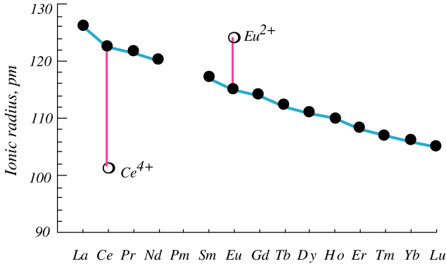
Rare earth metals
Often reported in form of isotypic series
Correctness of the metal is difficult to check (refinement of s.o.f. ambiguous)
Use the Check for similar reduced cells option provided at your homepage to
search for isotypic structures and consider the lanthanide contraction:
Deviation of the expected decrease of the unit cell volume with increasing atom
number is a clear warning sign!
In such cases check the deposited structure factors for similarity with PLATON

Slide 19
Conclusion and Recommendation
For validation, use checkCIF output provided in the review *.pdf
or at your homepage
It is recommended to always re-refine the structure (→ occupancies of
metal atoms, location of H atoms from difference Fourier maps etc.)
– just a few mouse clicks / keys with PLATON!
Using programs and tools like/within PLATON, publCIF, Mercury,
etc. will make your life easier!
Nevertheless, always consider your chemical intuition!
Thanks to all of you for your work and input for the journal!

